Slide 1









CRC Diagram – Class, Responsibility & Collaborator
Defining Object Responsibilities and Collaboration
User
WasteReport
CLASS
RESPONSIBILITIES
COLLABORATORS
CLASS
RESPONSIBILITIES
COLLABORATORS
User
Authentication
Profile management
Role-based access
Submit cleanliness report
Receive notifications
WasteReport
Notification
WasteReport
Create cleanliness report
Store problem details
Store location and photo
Track report status
Initiate cleaning task
User
Location
CleaningTask
Notification
Cleaner
CleaningTask
CLASS
RESPONSIBILITIES
COLLABORATORS
CLASS
RESPONSIBILITIES
COLLABORATORS
Cleaner
Receive cleaning tasks
Accept assigned task
Update task status
Manage availability
Upload completion evidence
CleaningTask
CleanerAvailability
PhotoEvidence
Notification
CleaningTask
Assign eligible cleaner
Track task lifecycle
Manage priority
Record completion
Support reassignment
WasteReport
Cleaner
Supervisor
Notification
User
WasteReport
CleaningTask
Cleaner
Supervisor
Core Collaboration Flow

Slide 2









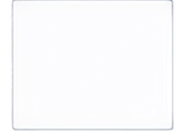






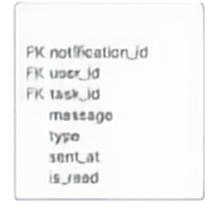









USER
PK user_id
name
email
password
role
phone
ERD —
Entity Relationship Diagram
WASTE_REPORT
PK report_id
FK user_id
FK location_id
category
description
status
priority
photo_path
created_at
LOCATION
SUPERVISOR
PK location_id
building
area
longitude
PHOTOEVIDENCE
PK supervisor id
FK user_id
Database Structure of Smart Clean Campus
PK evidence id
FK task_id
photo_path
evidence type
uploaded_id
CLEANINGTASK
NOTIFICATION
PK task_id
FK eSport id
FK cleaner_id
status
priority
assigned_id
completed_id
  PK notification id
  FK user id
  FK task_id
  message type
  sent_at
  is_read
VERIFICATION
PK verification id
FK supervisor id
decision
remarks
verified_id
CLEANER
PK cleaner_id
FK user_id
status
current location
CLEANER AVAILABILITY
PK availability id
FK cleaner_id
status
reason
document_path
start_time
end_time

Slide 3
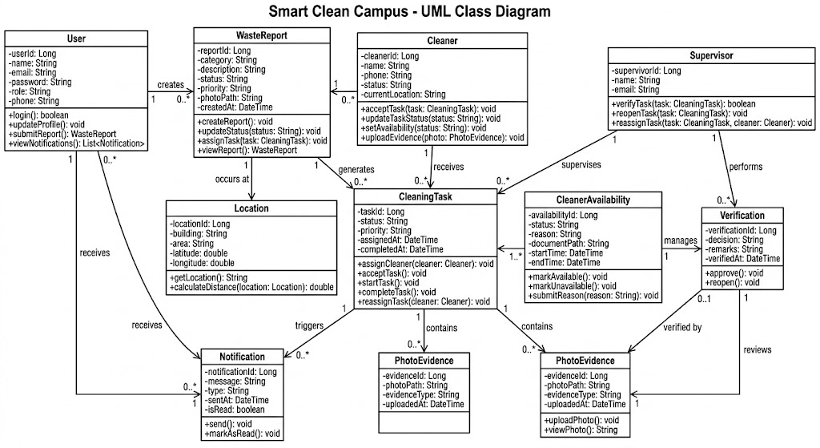

Slide 4
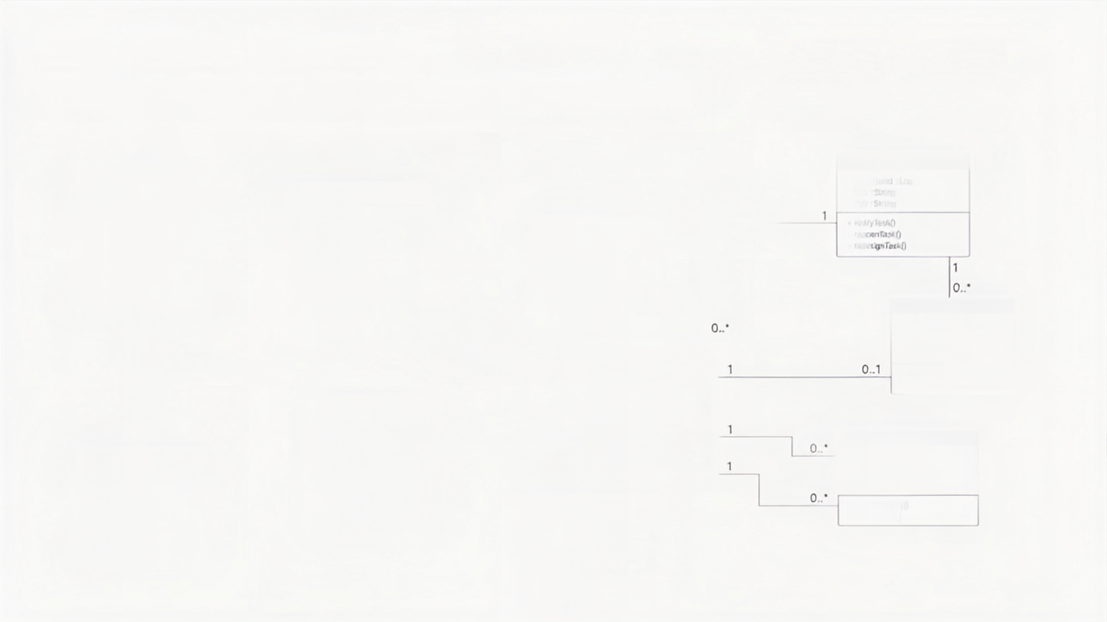


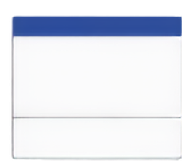





UML Class Diagram —
Object-Oriented System Structure
Classes, Attributes, Methods and Relationships
USER
SUPERVISOR
username : Long
name : String
email : String
password : String
role : Role
phone : String
supervisor: Long
name : String
email : String
WASTE_REPORT
1
0. *
reportid : Long
category : String
description : String
status : Reportstatus
priority : Priority
photoPath : String
createdAt : DateTime
1
LOCATION
+ verify/Task(s)
+ recuperate(s)
+ reassignTask(s)
Location: Long
building : String
area : 2000
longitude : double
+ login(s)
+ update(Profile)
+ submit/report(s)
+ view/notifications(s)
1
1
1
+ create/Report
+ update/Status
+ assign/Task(s)
+ view/Report(s)
0. *
+ get/Location(s)
+ calculate/Distance(s)
VERIFICATION
verification: Long
decision : String
remarks : String
verified : DateTime
CLEANINGTASK
task id : Long
status : TaskStatus
priority : Priority
assigned40 : DateTime
completed40 : DateTime
0. 1
+ approve(s)
CLEANER
cleaner id : Long
name : String
phone : String
status : Availability | Status
current/Location : Local
+ acceptTask(s)
+ complete/Task(s)
+ reassignTask(s)
0. *
1
0. *
cleaner(s)
1
PHOTO/EVIDENCE
0. *
0. *
0. *
0. *
evidence : Long
photoPath : String
evidenceType : String
uploadated40 : DateTime
NOTIFICATION
0. *
notifications : Long
message : Long
type : String
sent at : DateTime
isRead : boolean
1. *
+ acceptTask(s)
+ update/Task(s)
+ setAvailability(s)
+ upload/evidence(s)
1. *
0. *
+ upload/Photo(s)
+ view/Photo(s)
+ send(s)
+ mark/AsRead(s)

Slide 5
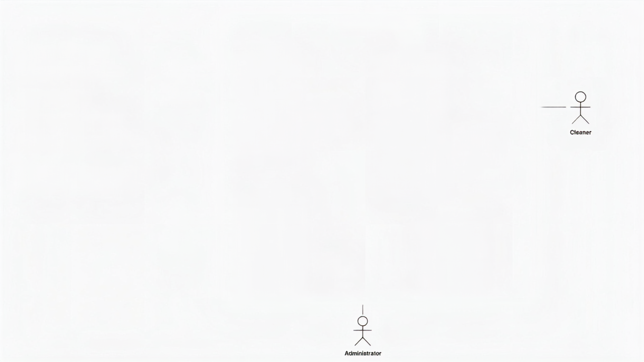
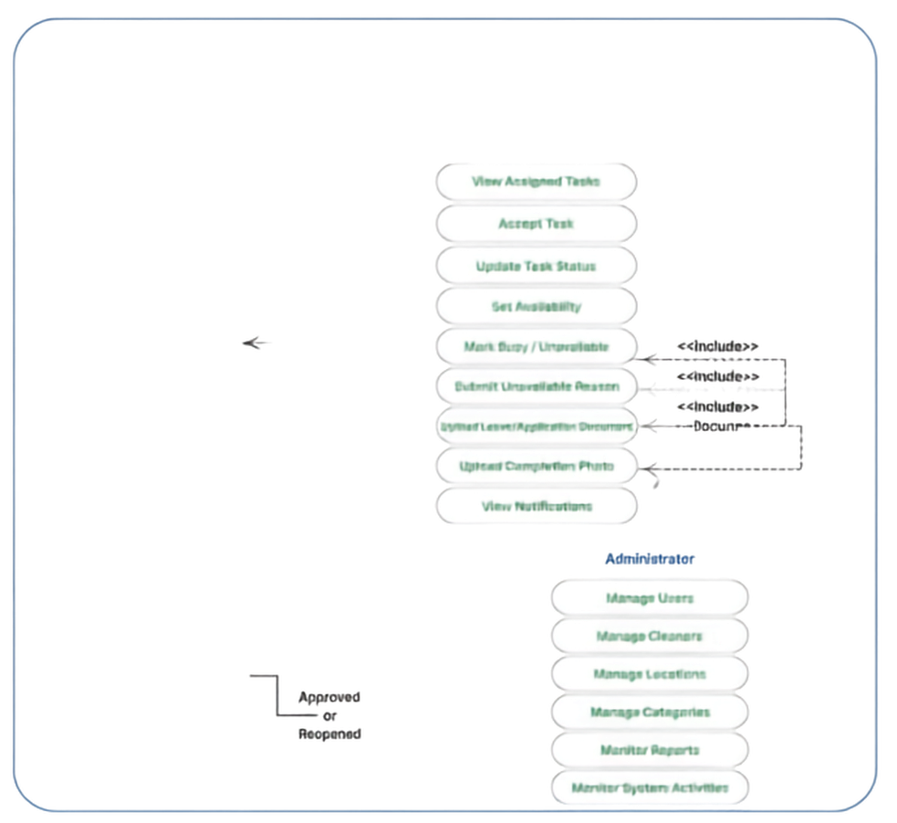


















Smart Clean Campus
Use Case Diagram — System Functional Requirements
Campus User
Cleaner
Register / Login
Login
Manage Profile
View Assigned Tasks
Submit Cleanliness Report
Accept Task
Campus User
Upload Problem Photo
Update Task Status
Provide Location
Set Availability
Track Report Status
Mark Busy / Unavailable
Cleaner
Submit Unavailable Resson
View Notifications
Actors and Their Interactions with Smart Clean Campus
Upload Leave/Application Document
Supervisor
Upload Completion Photo
Login
View Notifications
Monitor Cleaning Tasks
Administrator
Monitor Cleaner Availability
Manage Users
Review Completion Evidence
Manage Cleaners
Supervisor
Verify Completed Task
Manage Locations
Reopen Task
Manage Categories
Reassign Task
Monitor Reports
Monitor Report Resolution
Monitor System Activities
Administrator

